Slide 1
Movie Recommendation System using Collaborative Filtering Neural Network with Embeddings
Kaan Tek - 21901946
Kerem Şahin - 21901724
Melih Fazıl Keskin - 21901831
Miray Ayerdem - 219101987
Sanaz Gheibuni - 22201383
Notes:
Hello, Welcome to our final presentation, our project is a movie recommendation system

Slide 2
Table of contents
1.
2.
3.
4.
5.
6.
7.
8.
Introduction
Data Preprocessing
Neural Collaborative Filtering (NCF)
Evaluation Metric
HyperParameter Tuning
Explicit Feedback
Tsne
References

Slide 3
Introduction: Chosen Method
for Movie Recommendation
Collaborative Filtering
Uses the ratings or feedback of other users who have similar preferences to the target user
It creates embeddings for both users and items on its own
Notes:
I will quickly remind you the things that we talked during the progression presentation. This system uses collaborative filtering which uses the ratings or feedback of the users as training information

Slide 4
Data Preprocessing: Our Methodology

Slide 5
Explicit vs Implicit Feedback
Explicit Feedback
Implicit Feedback
+Direct and quantitative data collected from users
+Rate watched movies on a scale of 1–5
+Collected indirectly from user interactions
+Abundant
+Today, many recommendation systems are built using implicit feedback
Notes:
So there are two types of collaborative filtering and our first model uses implicit feedback which is the most common way to build a recommendation system and we also built a model which uses explicit feedback

Slide 6
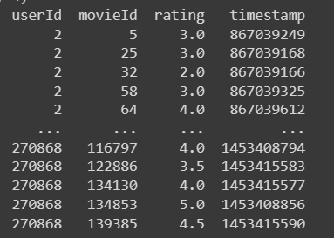
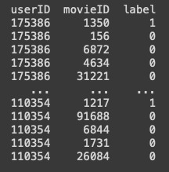
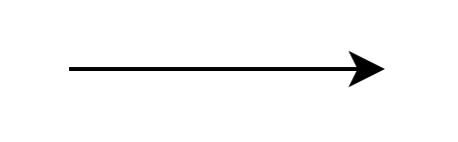
Dataset
- Our dataset has:
138k unique userID
131k unique movieID
20M ratings along with timestamps
Transformed the data to simulate interaction behaviour
Notes:
So, we processed our dataset according to our purposes. At the end the data columns are like in the second picture for the implicit feedback. For explicit, we kept the rates instead of label column.

Slide 7
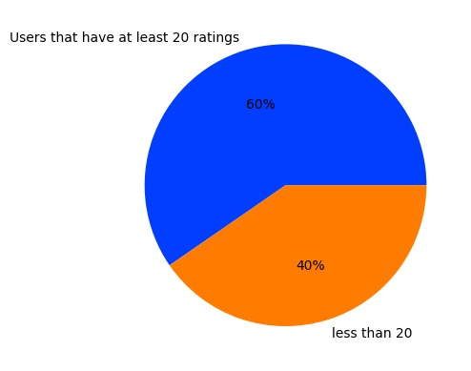
Dataset
Pandas pie chart:
- In our dataset, 40% of the users have less than 20 ratings.
-We filtered the users who have less than 20 ratings for our training dataset.
Notes:
Then we discarded all users who watched less than 20 movies.

Slide 8
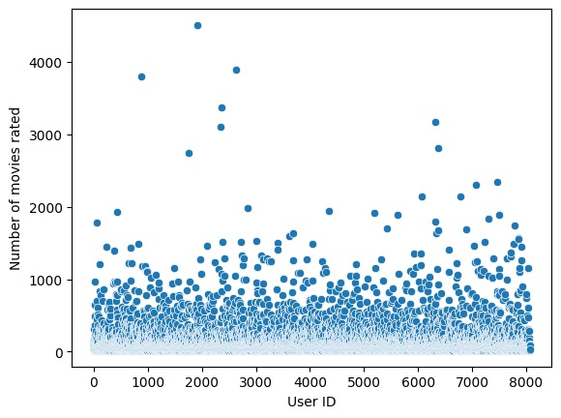
Dataset
-Choose randomly 5% of users.
-Over 1.2 mil rows (ratings) of data from around 8074 randomly chosen users
-Many users have ratings less than 1000 as expected.
Notes:
In order to keep memory usage manageable, we selected data from 5% of the remaining users in this dataset and here you can see how the number of watched movies is distributed.

Slide 9
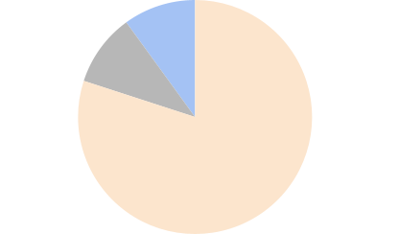
Train-Validation-Test Split
Training :
Ratings with older dates
Validation :
Second newest rating
Test :
Newest ratings
Notes:
Then we splitted our data set into training, validation and test set. While doing that, we put the newest ratings from each user to test set since it is more logical to predict new ones by looking at the old ones. With the same logic, we put the second newest ones to validation set and the remaining ones to test set. For the implicit feedback, we added 4 negatives samples to training set for each positive sample because we couldn't include all of the negative samples since we have a large dataset. For the explicit feedback, we only used the given ratings

Slide 10
Training Dataset
-In the Figure 2, we saw that the rating numbers of users are generally between 20 and 1000.
-We have 20.875 movies in total.
- If we were to combine each user with each movie that exists in our dataset, we would get a very imbalanced data since users are interacted with a very small portion of all the movies. Hence, we would have many 0 labels in our data
-Therefore, in our training set, instead of taking into account every unwatched movie, we generated 4 negative samples for each row of data (positive data). In other words, the ratio of negative to positive samples is 4:1.
Notes:
Explain that we will try different ratios such as 3:1 etc

Slide 11
Validation dataset
-We used our validation set to see the effects of different values in parameters and ratio to determine the most optimal values for the model and then train our model respectively.
-To obtain results from validation set, we will use Hit Ratio @10

Slide 12
Test Dataset
- Test dataset is used the evaluate the final model that is obtained after we apply hyperparameter tuning.

Slide 13
Embeddings
User Embeddings
Movie Embeddings
In this embedding, users with similar movie preferences are placed near to each other, and vice versa.
Similarly, we will use a separate item embedding layer to represent similar movies in a lower dimensional space.
Notes:
An embedding is a low-dimensional space that captures the relationship of vectors from a higher dimensional space.
Essentially, the embedding reduces our users such that they can be represented in a meaningful manner in a lower dimensional space. As well as movies.

Slide 14
NCF: Model Architecture
(0.2,0.8)
Prediction vector
Output
Fully Connected Layers
((0.67,0.2,...,0.01),(0.07,0.12,...,0.11)) Concatenated vector
NCF model
(0.67,0.2,...,0.01)
Embedded user vector
(0.07,0.12,...,0.11)
Embedded movie vector
User ID | Movie ID | Interaction
3 | 1 | 1
User Embedding
Item Embedding
Input
(0,0,1,.0.)
User ID 3
(1,0,0,..0)
Movie ID 1
Notes:
Now that we have a better understanding of embeddings, let’s explain Neural Collaborative Filtering model more in detail. What we do here is basically a one implementation of neural network. Hence, we will be working with neurons and layers. As you can see in this simple example, one instance of user and movie are fed to the model, and after embedding and going through various other layers, it gives us the output of probability of the user watching that movie

Slide 15
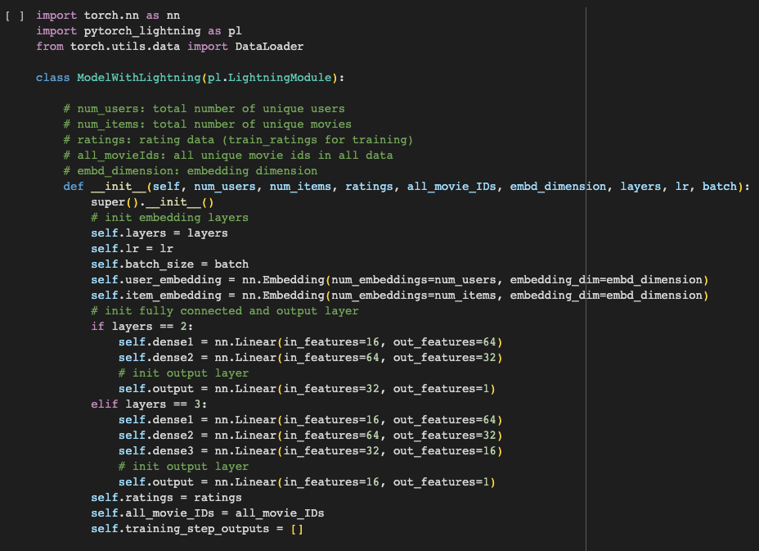
Our Model
PyTorch / Lightning framework
5 layers:
1 user and 1 item embedding layer
2 dense layers that take concatenation of user and item embeddings
1 output layer
Notes:
In our implementation of the model, we have 5 layers in total. 2 of them are used to embed user and movie IDs, respectively. Then these embeddings are concatenated together and fed into two other dense, in other words fully connected layers. These 2 layers use a ReLU function. The ReLU function is used to introduce non-linearity to our model. Finally, we arrive at the output layer, which consists of a single neuron that has a Sigmoid activation function. This neuron gives an output value between 0 and 1, which represents the probability that the user will like the item. This result is then used as a ranking score to recommend the top-10 items to the user, which we will explain more in detail later.
But which technologies did we use to implement this Neural Network? We highly benefited from PyTorch library, as it is very useful for implementing deep learning models. In our first implementation, we also used PyTorch’s Lightning framework, which provides a high-level interface for training deep learning models.
But later on, we managed to implement a model without using Lightning library and pure PyTorch as well. And we wrote our code on Google Colab.

Slide 16
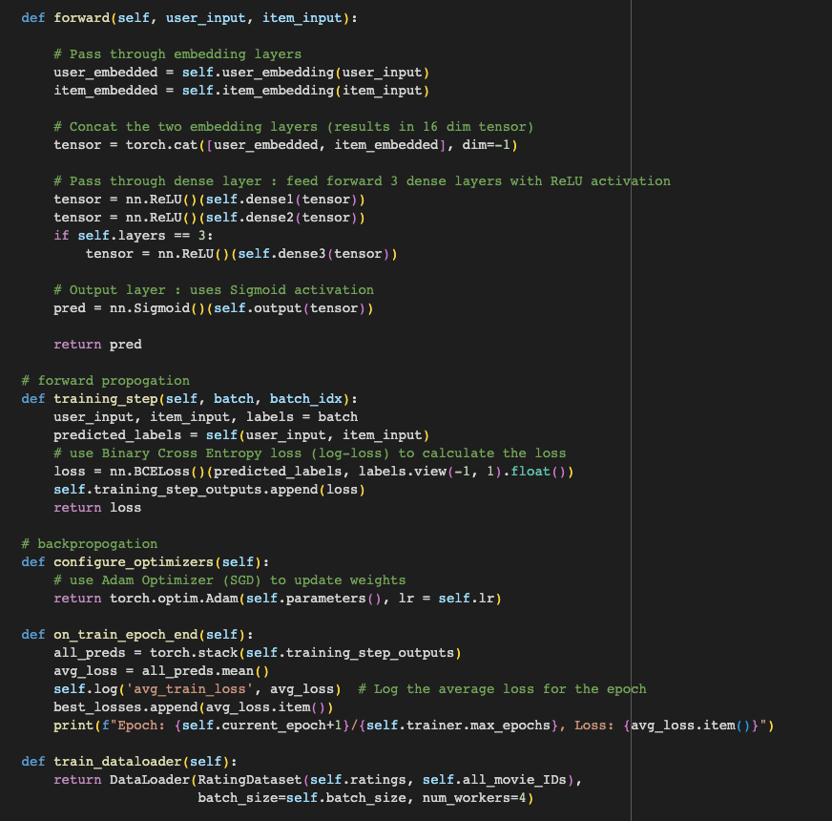
Forward method that takes user input and item input
Training step that contains binary cross entropy loss to calculate the loss
Adam optimizer to update the weights
Dataloader to load and process the training data in mini-batches during the training process.

Slide 17
Evaluation Metric: Hit Ratio @ 10
Traditional methods:
Accuracy(classification)
RMSE(regression)
Suitable metric:
Hit Ratio @ 10
-Too simplistic for recommender systems
Notes:
Now in order to evaluate the performance of our model, we had to choose a performance metric. Traditional performance metrics such as accuracy, precision, and F1-score are not always suitable for recommendation systems because the traditional performance metrics evaluate the performance of a model based on its ability to predict individual labels, rather than to rank a large number of items based on their relevance. Additionally, recommendation systems usually deal with highly imbalanced datasets, where the majority of items have no interaction with the user. Hence, we used another metric, 10 Hit Ratio.

Slide 18
Evaluation Metric: Hit Ratio @ 10
- Randomly select 99 items that a user has not interacted with and combine them with the actual item that the user last interacted with.
-After running the model, choose the top 10 items from this list, and if the actual item is present within the top 10, it's considered a "hit".
-Repeat this process for all users, and the Hit Ratio is the average hits. This protocol is widely used to evaluate the performance of recommender systems.
Notes:
It is an evaluation metric commonly used in recommender systems to measure the ability of a model to recommend relevant items to a user
The details are written here, I wont explain them all because of time issues, but basically our model gives us movies that the user is likely to interact with, and we observe how many of them user actually had interacted with in the past.
And once we trained our model with our training data and tested on our validation set, we obtained %80 percent hit ratio, which is a great as this can be interpreted as out of 10 movie sets that we recommend a user, they are likely to watch a movie from 8 of those sets.

Slide 19
HyperParameter Tuning
Model size (number of layers/neurons)
2 hidden layers: 16 and 64 neuros
3 hidden layers: 16, 64, and 32 neurons
Batch size
256, 512
Learning rate
0.001, 0.01, 0.1
Notes:
In order to determine the best combination of hyperparameters and come up with the optimal model, we did hyperparameter tuning. Our hyperparameters were the size of our network, batch size, and learning rate. We tested two combinations of a model, one having 2 hidden layers with 16 and 64 neurons in each, and other having 3 hidden layers with 16, 64 and 32 neurons in each. We also tested two combinations of batch sizes, 256 and 512. The batch sizes we used are relatively huge, but we used them because after our initial tests with smaller batch sizes, the training took a lot of time due to our large data, and the time required for convergence was not that much different than larger batch sizes, so after our initial experiments, we continued with larger batch sizes. For learning rate, we tested three different values. Therefore, in total, we trained and tested a total of 12 models.

Slide 20
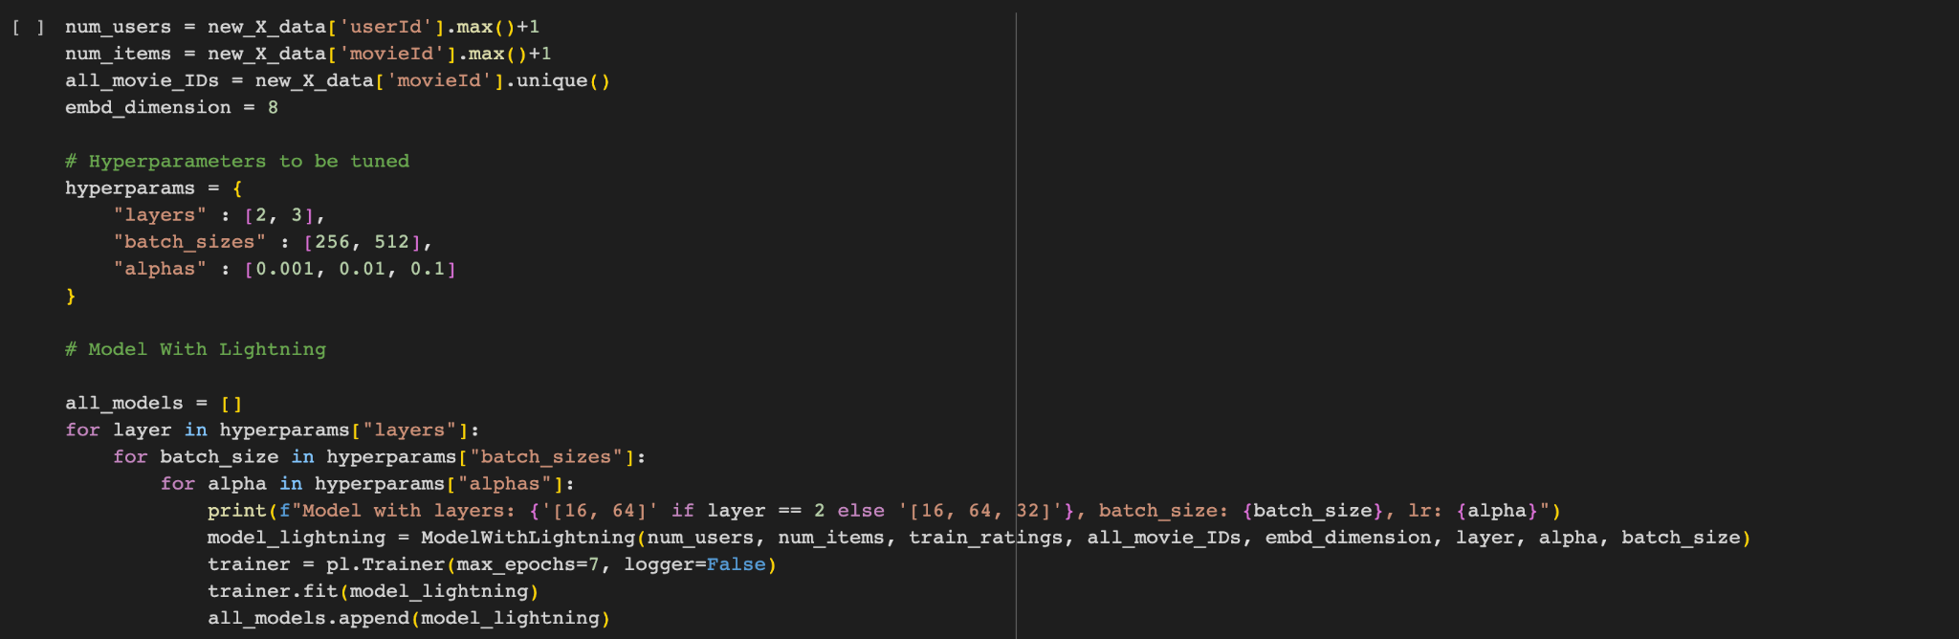
HyperParameter Tuning
Notes:
So this is the code that is used for our tuning. We trained a model for each combination of the hyperparameters, and then evaluated them with our 10 Hit Ratio metric by using validation set

Slide 21
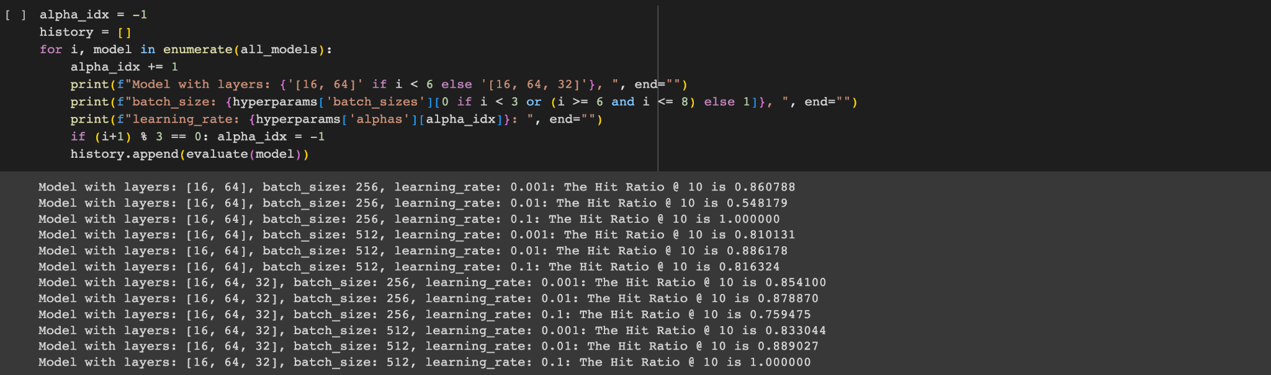
HyperParameter Tuning
Notes:
Here is the 10-hit-ratio result for all of the trained models. As can be seen, two models gave 1 out of 1 hit ratio, but we suspected that there could be some kind of overfitting during the training of these models, and in fact there was, because when we then tested them on our test data, the hit ratio significantly dropped. So we decided to choose among next two best performing models, which have around 0.88 hit ratio. The only difference between them was the size of the network, so we decided to use the model with 2 layers as it is less complex and performs the same as the more complex model with 3 layers. Hence, our final model has 2 hidden layers, 512 batch size, and 0.01 learning rate (For Implicit, Explicit is also tuned in a similar manner which is explained in the report)

Slide 22
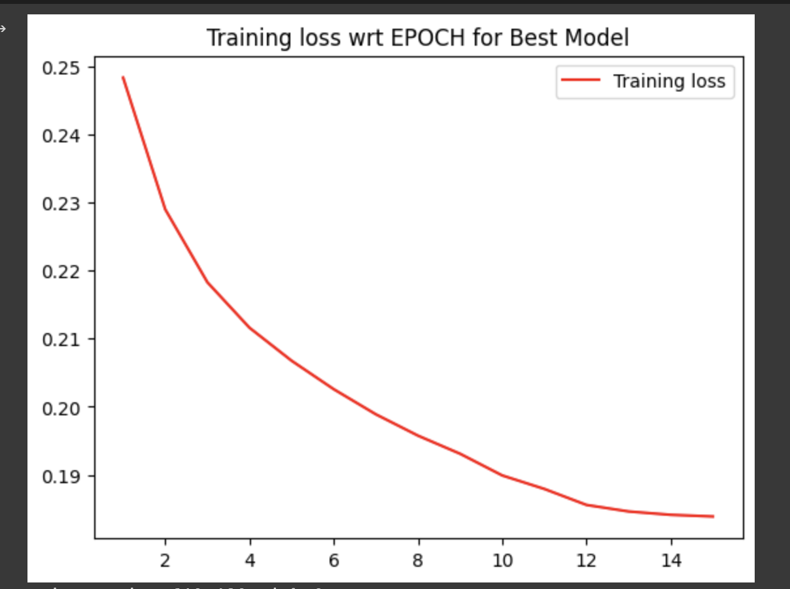
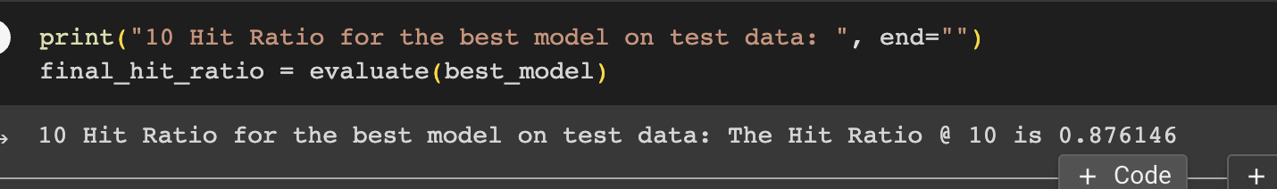
Final Model
Notes:
We then trained a new model with the chosen parameters by using our training and validation set as the training data, and tested it on the test data. The plot you see is the training loss of the model at the end of each iteration, and the final hit ratio we obtained was 0.87

Slide 23
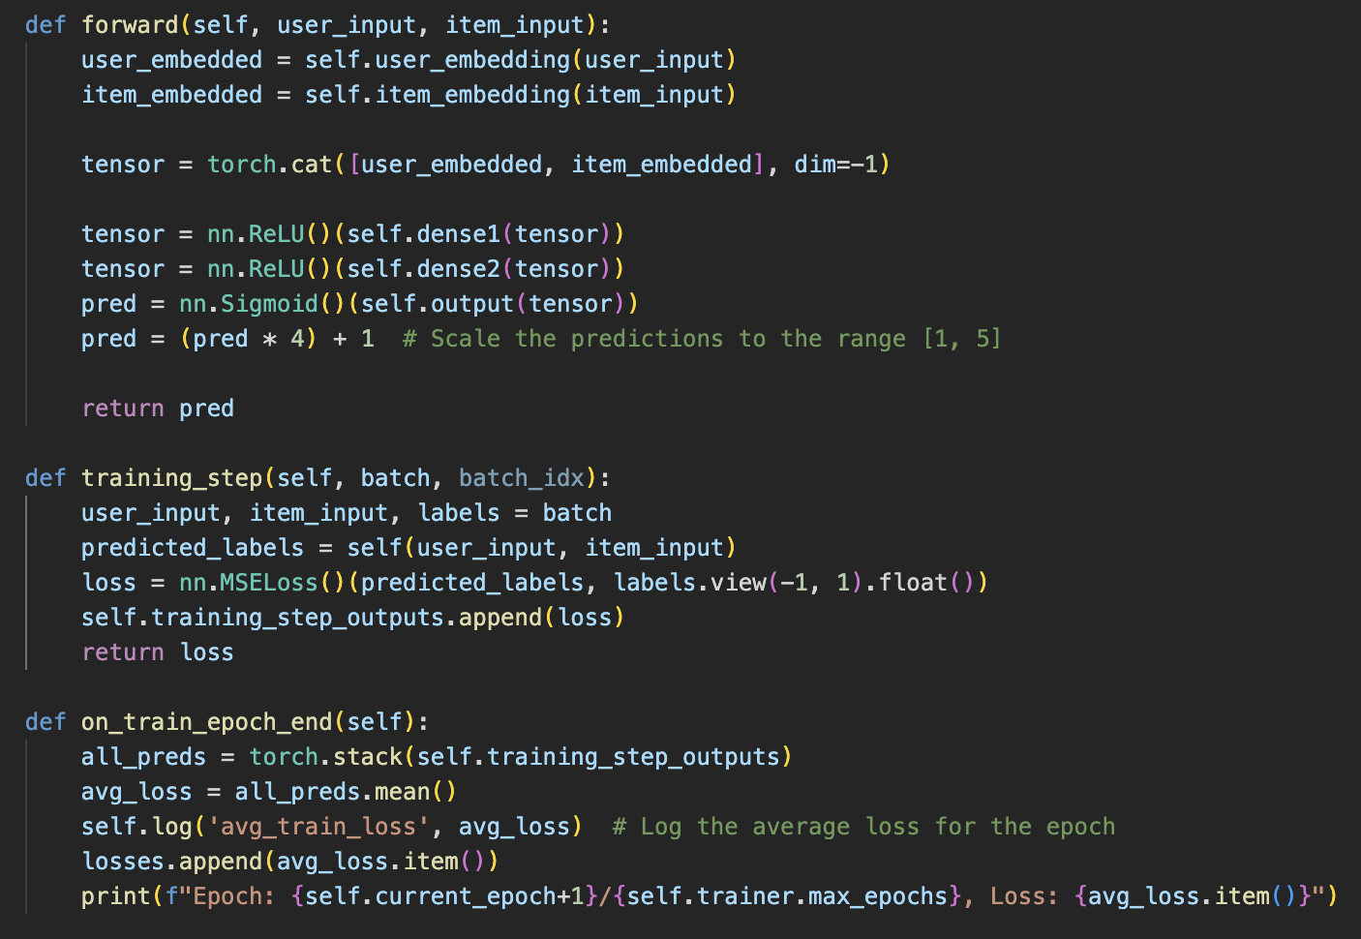
Explicit Feedback
Model Architecture

Slide 24
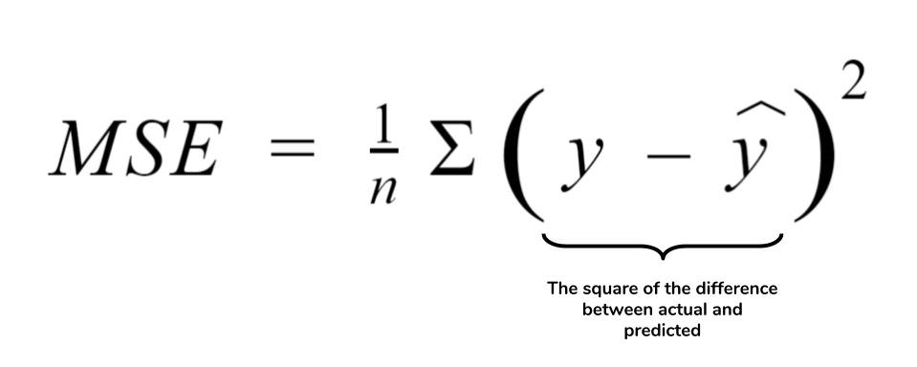
Explicit Feedback
In explicit feedback our model predicted ratings of user between 1 and 5.
We use MSE (Mean Squared Error) to train the model.
2 hidden layers = [16, 64,32]
Learning rate = 0.001
Batch Size = 256
-
Notes:
MSE (Mean Squared Error) is a common metric for rating prediction systems. It can be calculated by averaging the squared difference between the original rating and the predicted rating for all users and items. It indicates how well the model fits the data and gives more weight to large errors. MSE can be used for collaborative filtering.

Slide 25
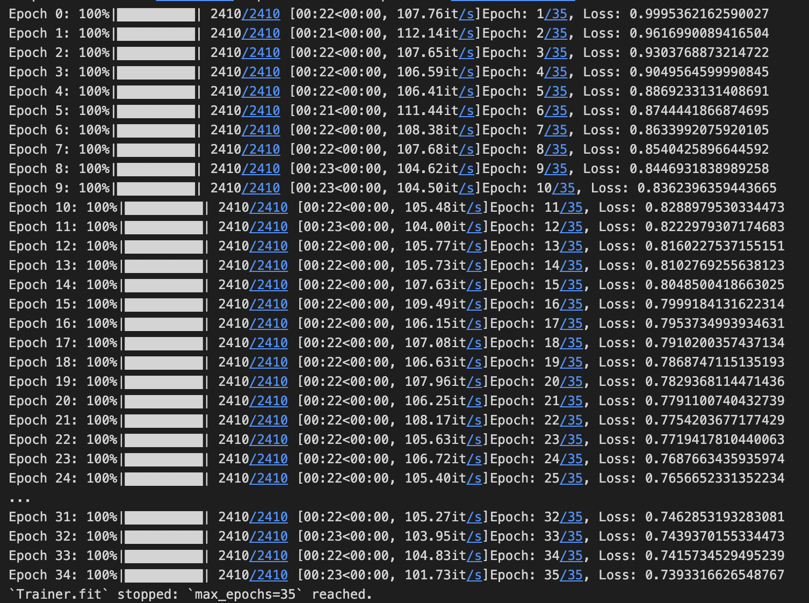
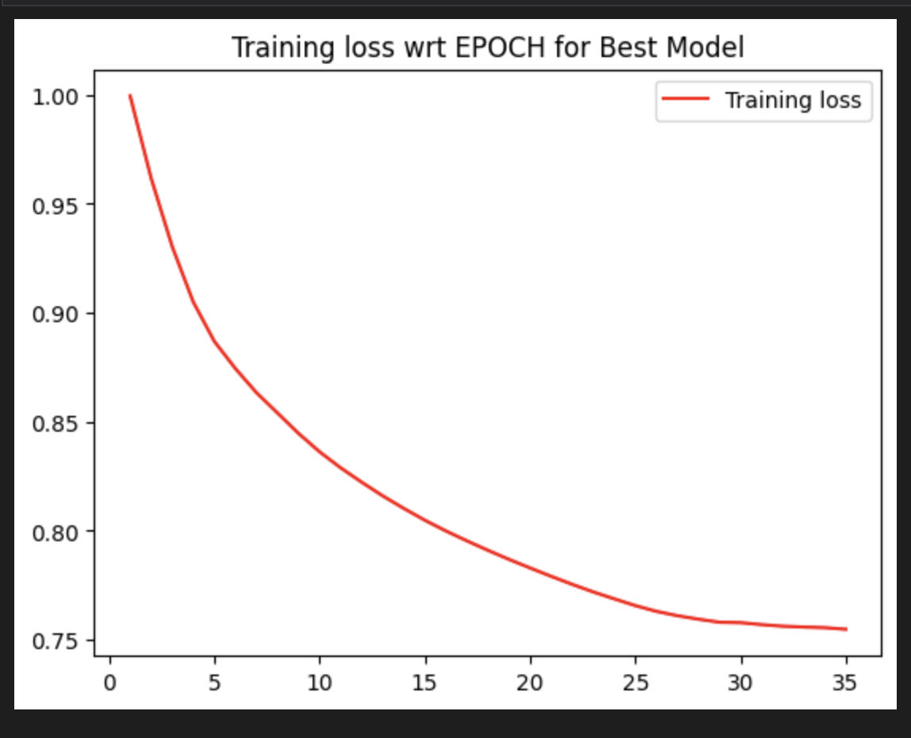
Explicit Feedback
Results

Slide 26
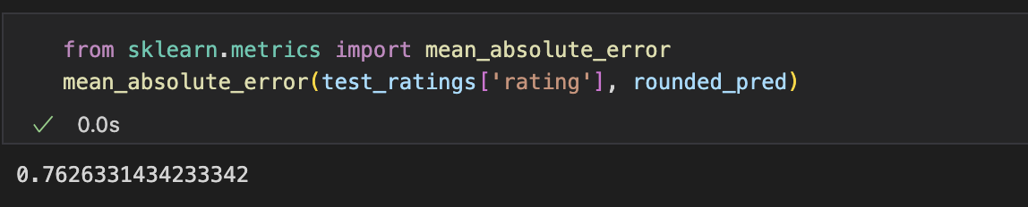
Explicit Feedback
Evaluation

Slide 27
Results & Comparison of Different Models
Implicit Feedback Model
Explicit Feedback Model
Loss: BCE
Evaluation Metric: Hit Ratio @10
Hit Ratio @10: 0.87
Learning Rate: 0.01
Batch Size: 512
Loss: MSE
Evaluation Metric: MAE
MSE
MAE: 0.76
Learning Rate: 0.001
Batch Size: 256

Slide 28
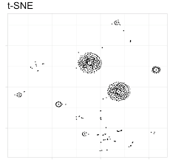
T-sne - What is it?
Example
Dimensionality reduction technique used for visualizing high-dimensional data
Preserves local relationships between data points by mapping similar points in the original space to nearby points in the lower-dimensional space

Slide 29
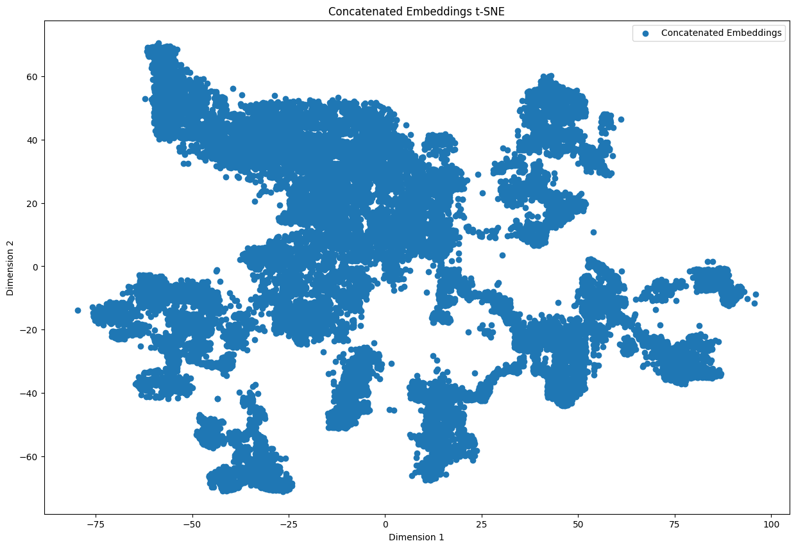
T-sne on Embedding Layers
Notes:
t-SNE (t-distributed stochastic neighbor embedding) can be used to visualize movie recommendation systems with embeddings. t-SNE is a statistical method for visualizing high-dimensional data by giving each datapoint a location in a two or three-dimensional map. It can help to explore the similarity and diversity of movies based on their embeddings,....

Slide 30
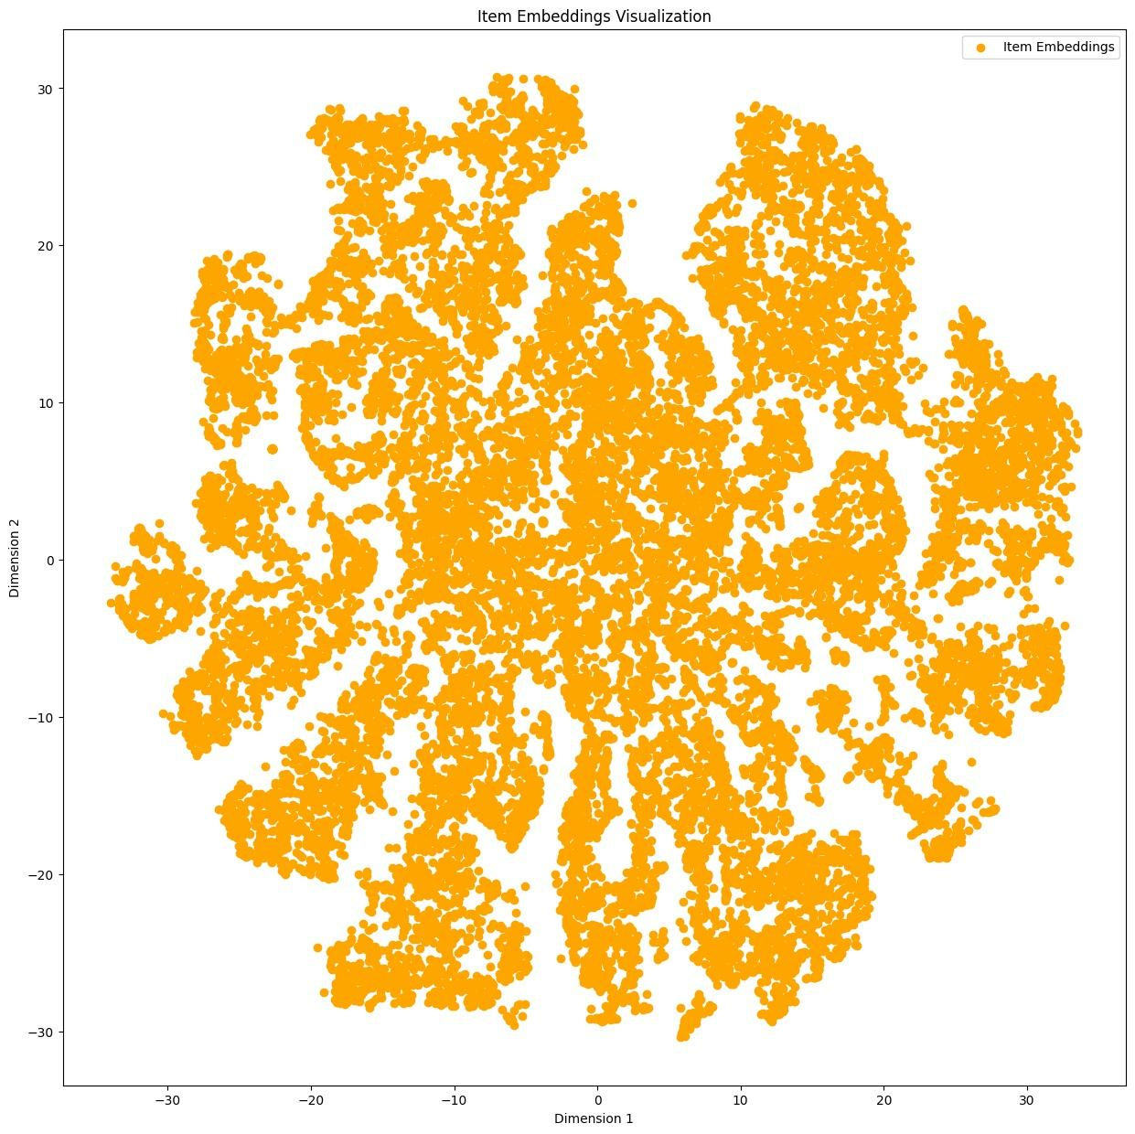
T-sne on Embedding Layers

Slide 31
References
“Collaborative filtering | machine learning | google developers,” Google. [Online]. Available: https://developers.google.com/machine-learning/recommendation/collaborative/basics. [Accessed: 23-Apr-2023].
“Introduction to Recommender Systems,” Medium. [Online]. Available: https://towardsdatascience.com/introduction-to-recommender-systems-1-971bd274f42. [Accessed: 24-Apr-2023].
“(PDF) movie Recommender System using collaborative filtering - researchgate.” [Online]. Available: https://www.researchgate.net/publication/348239082_Movie_Recommender_System_Using_Collaborative_Filtering. [Accessed: 25-Apr-2023].
“Pytorch Lightning,” Lightning Open Source. [Online]. Available: https://www.pytorchlightning.ai/index.html. [Accessed: 25-Apr-2023].
Notes:
In the next steps of our project, we are going to tune some of our hyperparameters that we mention here, by testing them on our validation sets. We might use k-fold cross validation or grid search for this. And then we will come up with the optimal parameters and that will be our final model. And finally we will test that model on our real test data and evaluate again.

Slide 32
Thanks!
Do you have any questions?

